Slide 1




UX AUDIT REPORT
JULY 2023
High level expert review
Heuristic evaluation & user interviews

Slide 2
1. INTRODUCTION - What we did
Executive Summary
Goals and objectives
2. METHODOLOGY- Process and Methods
Nielsen's Heuristic Evaluation
Ben Shneiderman’s 'Eight Golden Rules of Interface Design
Arnold Lund's 34 Usability Maxims
Norman's Theory of Action
Web3 Design Audit Checklist Based on Web3 Design Principles by Beltran
3. FINDINGS - What we tested on
Recommendations
4. INSIGHTS AND NEXT STEPS - What we tested on
Recommendations
In this report

Slide 3

ARRAKIS FINANCE
UX AUDIT REPORT
INTRODUCTION

Slide 4
EXECUTIVE SUMMARY
In this comprehensive UX audit, we conducted an expert review of Arrakis Finance user experience based on Web3 usability guidelines and expert review checkpoints. The aim was to assess the platform's alignment with industry best practices, ensuring a seamless and user-centric experience for all users interacting with Web3 technologies.
Our review focused on evaluating critical aspects such as platform accessibility, navigation, search functionality, user education, error handling, and the integration of Web3 wallet functionalities. Through a meticulous assessment, we identified several areas that require immediate attention to enhance the overall user experience.

Slide 5
247 WEB USABILITY GUIDELINES
This review focused on evaluating critical aspects such as platform accessibility, navigation, search functionality, user education, error handling, etc. Through a meticulous assessment, we identified several areas that require immediate attention to enhance the overall user experience.
UX PRINCIPLES | COMPLIES | DOESN’T COMPLY | NOT APPLICABLE | COMPLIANCE RATE
Home Page | 11 Criteria | 2 Criteria | None | 84%
Task orientation | 19 Criteria | 3 Criteria | 2 Criteria | 86%
Navigation and IA | 17 Criteria | 2 Criteria | None | 89%
Forms and data entry: | 9 Criteria | None | 9 Criteria | 100%
Trust and credibility | 8 Criteria | None | None | 100%

Slide 6
UX PRINCIPLES | COMPLIES | DOESN’T COMPLY | NOT APPLICABLE | COMPLIANCE RATE
Writing and content quality | 18 Criteria | None | 1 Criteria | 100%
Page layout and visual design: | 30 Criteria | 3 Criteria | 1 Criteria | 94%
Search usability | 7 Criteria | 8 Criteria | 1 Criteria | 47%
Help, feedback and error tolerance | 18 Criteria | 5 Criteria | 2 Criteria | 82%
Total | 137 Criteria | 23 Criteria | 16 Criteria | 85%

Slide 7
REVIEW BASED ON WEB3 UX PRINCIPLES
This review focused on evaluating critical aspects involved in the integration of Web3 wallet functionalities.
UX PRINCIPLES | COMPLIES | DOESN’T COMPLY | NOT APPLICABLE | COMPLIANCE RATE
Transparency of Data provenance | 2 Criteria | 2 Criteria | None | 50%
Transparency of Transactions | 3 Criteria | 3 Criteria | 2 Criteria | 50%
Transparency of Smart Contract | 1 Criteria | 1 Criteria | 1 Criteria | 50%
Transparent User interaction History | None | 3 Criteria | None | 0%
Transparency of Code | 4 Criteria | 3 Criteria | None | 57%

Slide 8
UX PRINCIPLES | COMPLIES | DOESN’T COMPLY | NOT APPLICABLE | COMPLIANCE RATE
Human Readable Hashes Format | 1 Criteria | 2 Criteria | 1 Criteria | 33%
Time/Wait Management | 1 Criteria | 1 Criteria | None | 50%
Permanent Newbie Mode | 1 Criteria | 2 Criteria | None | 33%
Gas Price and Transaction Reversal | None | 3 Criteria | None | 0%
Sense of Community | 4 Criteria | None | None | 100%
Total | 17 Criteria | 20 Criteria | 4 Criteria | 45%

Slide 9
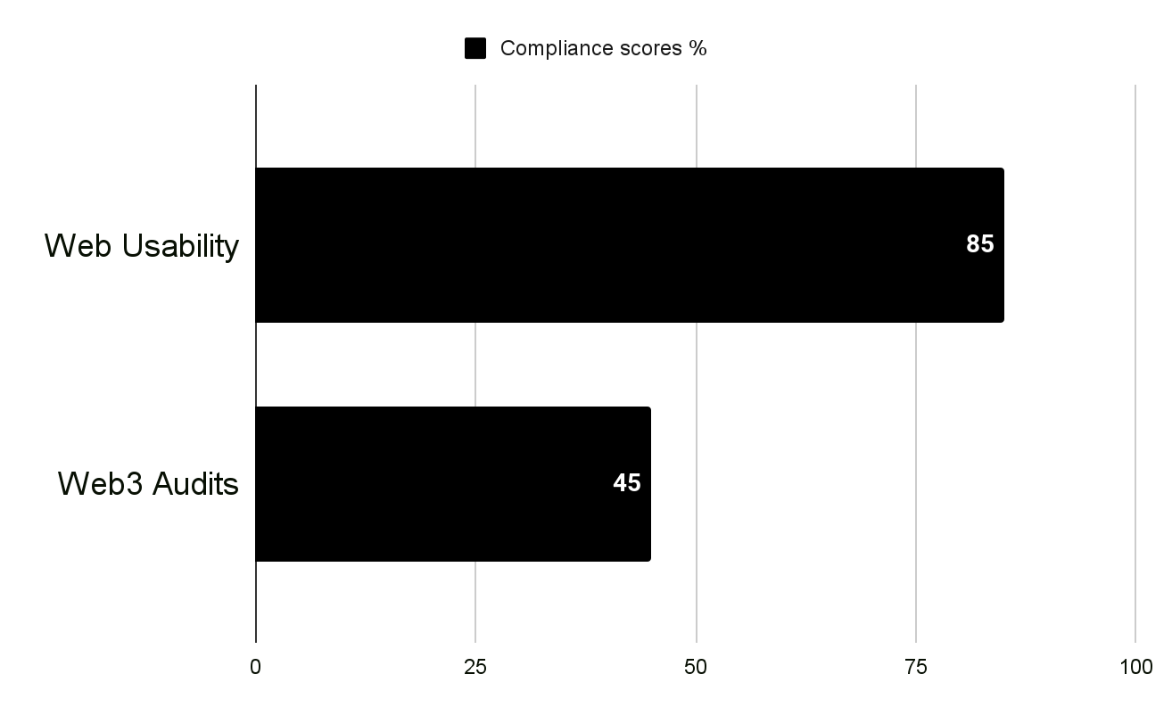
USABILITY STATS
Overall Compliance percentage
Usability Score
GOOD
78.17%
Users should be able to use this site or system with relative ease and should be able to complete the vast majority of important tasks.
Overall Compliance
Overall non compliance
154/197
43/197

Slide 10
PRODUCT OVERVIEW
Arrakis is web3's trustless market making infrastructure protocol that enables running sophisticated algorithmic strategies on Uniswap V3. Liquidity providers can utilize Arrakis Vaults to have their liquidity be managed in an automated, capital efficient, non-custodial and transparent manner.
CONTEXT OF THE AUDIT
This study involved collecting a rich research database consisting of detailed observations and findings based on Nielsen's Heuristic Evaluation, Design Arnold Lund's 34 Usability Maxims, and Web3 Design Audit Checklist Based on Web3 Design Principles by Beltran
These valuable resources complement and support the findings presented in this report.

Slide 11
ARRAKIS FINANCE
UX AUDIT REPORT
METHODOLOGY

Slide 12
METHODOLOGY
This report summarizes the findings of a comprehensive UX audit conducted on Arrakis Finance platform.
The audit utilized a combination of renowned UX methodologies, including Nielsen's Heuristic Evaluation, Ben Shneiderman’s 'Eight Golden Rules of Interface Design, Arnold Lund's 34 Usability Maxims, Norman's Theory of Action, and the Web3 Design Audit Checklist Based on Web3 Design Principles by Beltran.
The purpose of the audit was to assess the user experience and identify areas for improvement to enhance usability and overall satisfaction

Slide 13
SEVERITY SCALE
Critical
Severely impairs the use of the product and cannot be overcome by users. It is necessary to fix this before releasing the product..
Serious
Occurs frequently and persistently, or users may not be able to resolve the issue or may not be aware of it. It's important to fix this, so give it a high priority..
Medium
May occur more often or be harder to overcome. Fixing this should be a low release priority.
Low
Can be easily overcome by the user or occurs very rarely. The release does not require repair unless additional time is available.

Slide 14
ARRAKIS FINANCE
UX AUDIT REPORT
FINDINGS

Slide 15
BUSINESS GOALS
Building trustless market making infrastructure & strategies on Uniswap V3.
Democratize market making and enable DEXs to become the primary trading venue for all assets, even beyond crypto.

Slide 16
CUSTOMER GOALS
Liquidity Providers (LPs) : Arrakis is a protocol that is built for liquidity providers that are either regular retail LPs, institutional funds or web3 protocols themselves to enjoy actively managed concentrated liquidity on Uniswap v3. LPs retain full custody over their funds and can withdraw at anytime.
They can select three different options that define how their liquidity gets managed:
Trustless Vaults: Vaults that have a smart contract with a pre-defined strategy as their manager, which enable LPs to have trustless, autonomously managed on-chain strategies, similar to a Curve v2 like model. These could be static or dynamic.
Managed Vaults: Vaults that are operated by professional market makers running more sophisticated off-chain strategies.
Self Managed Vaults: Vaults that can only be used by single entities which are also the manager at the same time and thus have full control over it. Only for advanced users.
Professional Market Makers (Managers)
The other possibility exists for market makers and sophisticated traders that can offer to manage the liquidity of other LPs in return for a % share of their fee earnings.

Slide 17
FINDINGS
Heuristic Used
Select the appropriate heuristics principle that matches the usability issue you’ve identified.
Severity
From the severity scale, select the appropriate rating for the usability issue you’ve identified.
Issue and Recommendation
Describe the usability issue and spell out your recommendations for UX improvements.

Slide 18
ARRAKIS FINANCE
UX AUDIT REPORT
ONBOARDING AND FIRST IMPRESSION
The primary goal of the onboarding process is to help users understand and become proficient in using the product, thereby reducing any potential barriers to adoption and improving overall user satisfaction. It sets the stage for a positive user experience and lays the foundation for long-term engagement and retention.

Slide 19
Issue (MEDIUM)
Recommendations
The current platform falls short in delivering a professionally designed home page that would create a positive first impression. Design elements, layout, and visual aesthetics lack cohesion and fail to convey a sense of credibility and professionalism, potentially hindering user engagement.
The current platform lacks a home page design that effectively encourages users to explore the site. The design elements and layout do not provide an intuitive visual hierarchy or incentives for users to delve deeper into the platform's content, potentially hindering user engagement and interaction.
Simplify and Declutter: Streamline the home page by decluttering unnecessary elements. Prioritize key information, features, or actions that align with the platform's goals. A clutter-free design enhances clarity and user focus.
Clear Call-to-Action (CTA): Implement a clear and strategically placed CTA on the home page. The CTA should guide users toward meaningful actions, such as signing up, exploring features, or accessing important content.
Storytelling Elements Integration: Consider integrating storytelling elements to effectively communicate the platform's mission, values, and unique selling points. Engaging narratives can create a memorable and positive user experience.

Slide 20
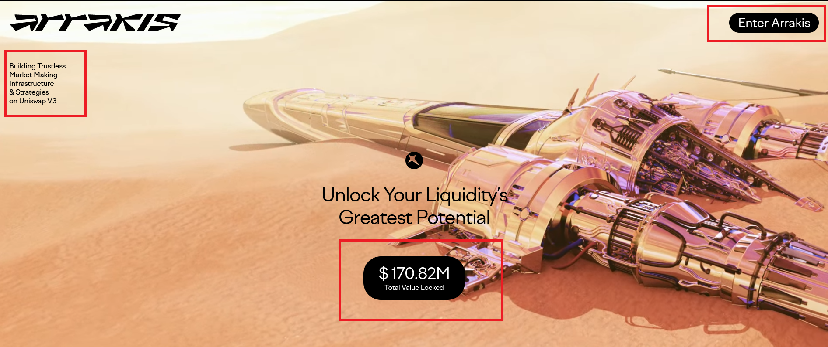
Important information are seemingly all over the place on the page. The CTA button is not very prominent and has the same style as the Total Value locked Information. The CTA Button should be styled differently and made the focal point on this page.

Slide 21
ARRAKIS FINANCE
UX AUDIT REPORT
TASK ORIENTATION AND SITE FUNCTIONALITY
People go to web sites to achieve particular goals, not to look around and admire the design. This means web pages needs to support customer tasks. A site is task oriented when it supports users in the effective and efficient completion of their tasks.

Slide 22
Issue (MEDIUM)
Recommendations
The platform does not present a clear and well-defined critical path that guides users through their intended tasks or workflows. Users may struggle to identify the optimal path to complete their goals, leading to confusion and inefficiency in task completion.
The current platform lacks effective mechanisms to make it easy for users to explore the site and experiment with different options before committing. The absence of intuitive exploration features may hinder users in understanding the platform's offerings and functionalities, potentially leading to a less engaging and user-friendly experience.
Interactive Onboarding: Develop an interactive onboarding process that introduces users to key features and functionalities. Provide guided tours or tooltips to help users understand how to navigate and explore the platform
Create a demo or sandbox environment where users can experiment with features without making any permanent changes. This allows users to gain hands-on experience and build confidence before committing to actions.
Implement progressive disclosure by gradually revealing advanced features or options as users explore the platform. This prevents overwhelming users with information while encouraging gradual exploration.

Slide 23
ARRAKIS FINANCE
UX AUDIT REPORT
NAVIGATION AND INFORMATION ARCHITECTURE
System or mechanism that allows users to move through different sections, pages, or features of a digital product. It includes menus, links, buttons, search bars, and other interactive elements that help users find and navigate to desired content or perform specific actions. Effective navigation design ensures that users can easily understand and access different areas of the product, enhancing usability and user satisfaction.
Information architecture (IA) involves the organization and structure of information within a digital product to facilitate efficient and intuitive access. It focuses on grouping and categorizing content in a logical and meaningful manner, ensuring that information is well-organized, easily discoverable, and understandable to users

Slide 24
Issue (LOW)
Recommendations
Some Features on the platform lacks a visible change when the mouse points at clickable elements, excluding cursor changes. This deficiency diminishes the platform's usability by depriving users of a fundamental visual cue that helps distinguish interactive elements from static content. The absence of this affordance could lead to confusion and hinder users in recognizing actionable components.
The platform does not provide adequate navigational feedback to indicate the user's current location within the site. Users are left without visual cues or indicators that help them understand their position in the site's hierarchy or navigate back to previous pages
Hover Effects: Implement subtle yet noticeable hover effects on clickable elements. This could include changes in color, background, or border to signify interactivity. The visual alteration should be consistent across the platform.
Contrast Enhancement: Ensure that the changes triggered by hovering provide sufficient contrast against the background or surrounding elements. This enhances visibility and ensures users can easily perceive the interactive nature of the element
Consistency Across Elements: Maintain consistency in hover effects across different types of clickable elements. Whether it's buttons, links, or interactive cards, users should experience a uniform visual change when the mouse hovers over these elements.

Slide 25
Issue (LOW)
Recommendations
The current platform lacks clear distinction between hypertext links that invoke actions (e.g., downloads, new windows) and those that lead to another page. This deficiency in differentiation could lead to user confusion, as users may not be able to anticipate the outcome of clicking on a link, potentially resulting in unintended actions or navigation errors.
Consistent Color Scheme: Establish a consistent color scheme for different types of links. For example, use a distinct color for links that perform actions, making it visually evident to users that these links have specific functionalities beyond page navigation.
Semantic Link Text: Use clear and semantically meaningful text for links that invoke actions. Avoid generic phrases and opt for descriptive text that indicates the nature of the action, such as "Download PDF" or "Open in New Window."

Slide 26
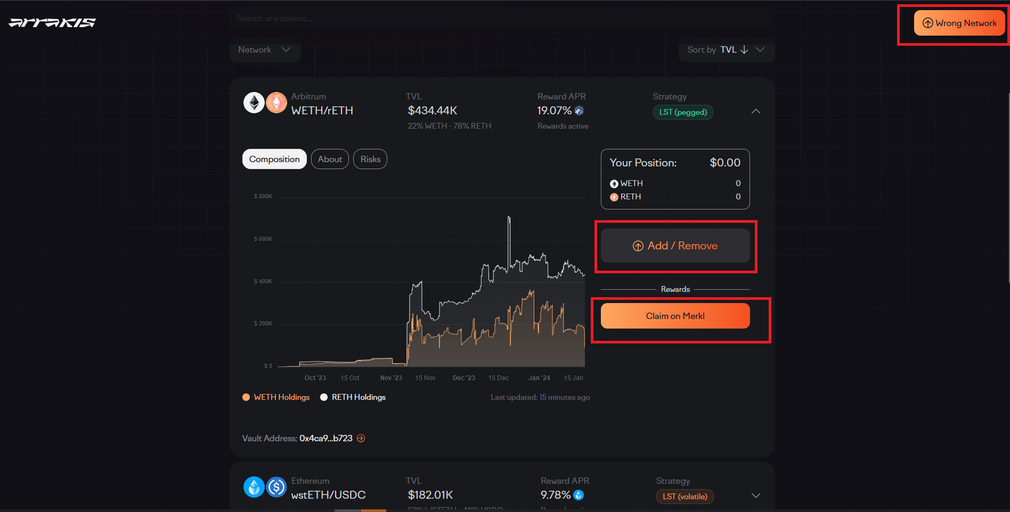
Visual Feedback:lacks a visible change when the mouse points at clickable elements, excluding cursor changes.

Slide 27
ARRAKIS FINANCE
UX AUDIT REPORT
PAGE LAYOUT AND VISUAL DESIGN
The checkpoints in this area ask if the dialogue is aesthetic and minimalist. Appropriate visual design means that the fonts, icons, colours and layout help the customer complete common tasks and that pages do not contain information that is irrelevant or rarely needed.

Slide 28
Issue (MEDIUM)
Recommendations
Some elements lacks adherence to an underlying grid, resulting in a lack of alignment for items and widgets both horizontally and vertically across pages. This absence of a consistent grid structure may contribute to visual clutter, uneven spacing, and an overall disjointed appearance, negatively impacting the platform's visual cohesiveness and user experience.
Some elements lack meaningful labels, and appropriate use of borders and white space to help users identify a set of items as a discrete functional block. This deficiency in visual cues compromises the user's ability to quickly grasp the structure and purpose of different content blocks, hindering overall comprehension and navigation.
Grid System Implementation: Establish and implement a robust grid system that guides the layout of pages. This grid should define both horizontal and vertical alignments, providing a structured framework for placing elements consistently across the platform.
Consistent Margins and Padding: Ensure uniform margins and padding around elements to maintain a visually pleasing and well-organized layout. Consistency in spacing contributes to a harmonious design and facilitates a more predictable user experience.

Slide 29
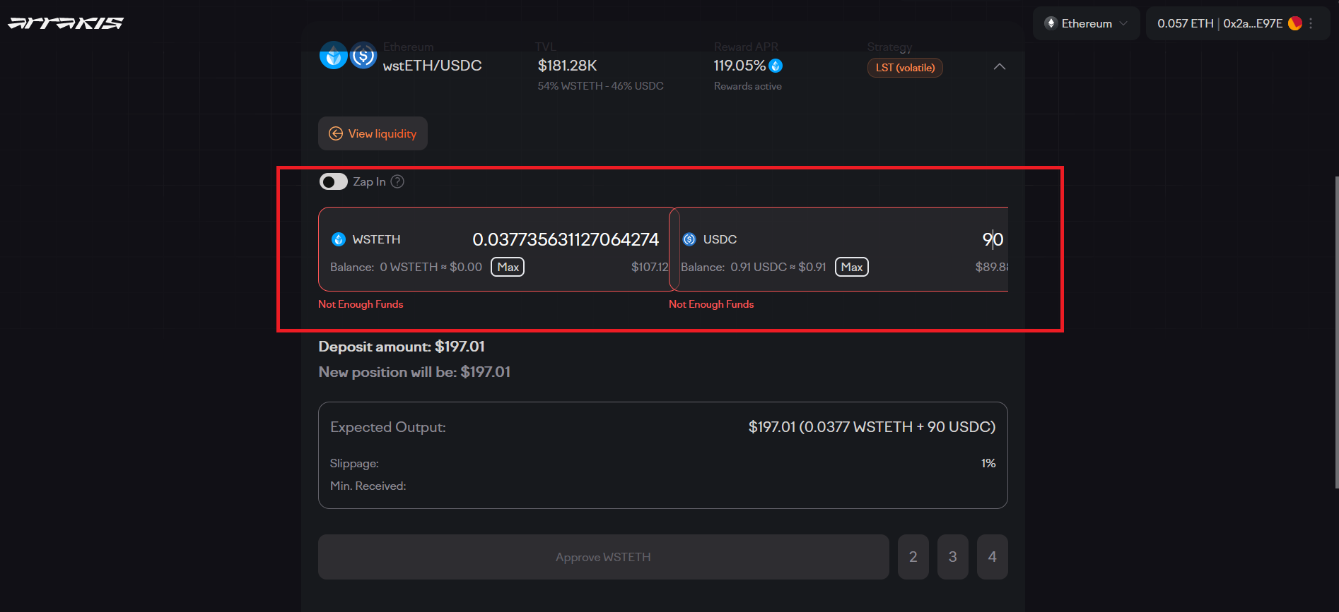
Input field has Visual clutter, padding with margin spacing, and an overall disjointed appearance.

Slide 30
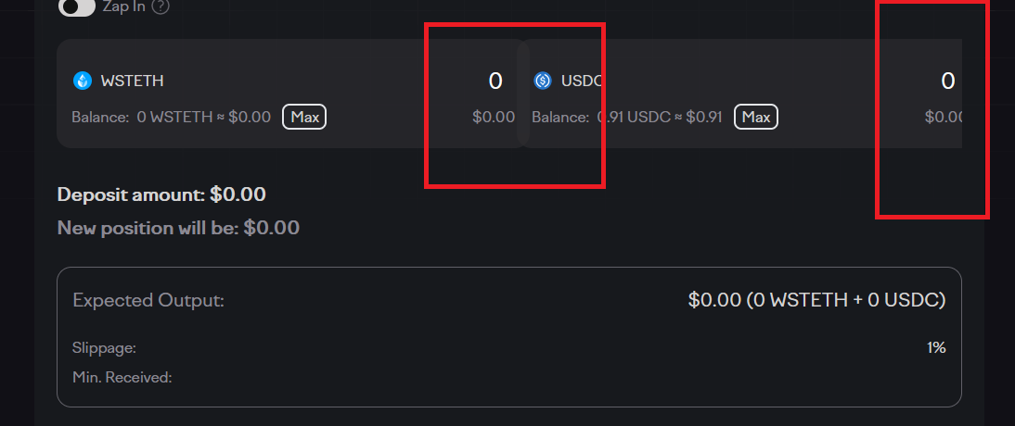
Input field has Visual clutter, padding with margin spacing, and an overall disjointed appearance.

Slide 31
ARRAKIS FINANCE
UX AUDIT REPORT
SEARCH USABILITY
Search is one of the dominant ways that many customers interact with web sites. A good search engine needs to acknowledge the 'human' side of searching, which means dealing with spelling errors and synonyms (such as 'laptop' for 'notebook'). Google has set the standard for how search should look and behave, and many of these guidelines are based on this best practice.

Slide 32
Issue (MEDIUM)
Recommendations
The platform does not effectively rank search results by relevance, making it challenging for users to find the most relevant content at the top of the results list. Users may have to spend additional time and effort sifting through irrelevant or less useful results, impeding their ability to accomplish their search goals efficiently.
The current platform lacks clarity on the search results page regarding the number of results retrieved, and there is no provision for users to configure the number of results per page. This deficiency diminishes user control and comprehension, impacting the overall search experience.
Present search results in a clear, organized manner that allows users to quickly scan and evaluate the relevance of each result. Provide essential information such as titles, summaries, and relevant metadata to assist users in understanding the content before clicking on a result.
Visible Result Count: Display a clear and visible count of the total number of search results on the search results page. This count provides users with an immediate understanding of the scope of their search and aids in managing expectations.

Slide 33
Issue (LOW)
Recommendations
The current platform fails to provide users with helpful suggestions or options when no results are returned from a query. This lack of guidance leaves users stranded without a clear path forward, diminishing the user experience and hindering their ability to refine their search effectively.
The current search functionality on the site lacks an intuitive and user-friendly approach for refining searches, as evidenced by the absence of a prominently featured "revise search" or "refine search" option. This omission hinders users in effectively narrowing down their search criteria, leading to potential frustration and a suboptimal user experience.
Error Messaging with Guidance: Implement informative error messages that not only communicate that no results were found but also offer constructive suggestions on how users can refine or modify their query. The guidance should be specific, addressing potential issues with the user's input.
Ineffective Search Refinement: The absence of a dedicated "revise search" or "refine search" feature limits users' ability to modify and enhance their search queries easily.

Slide 34
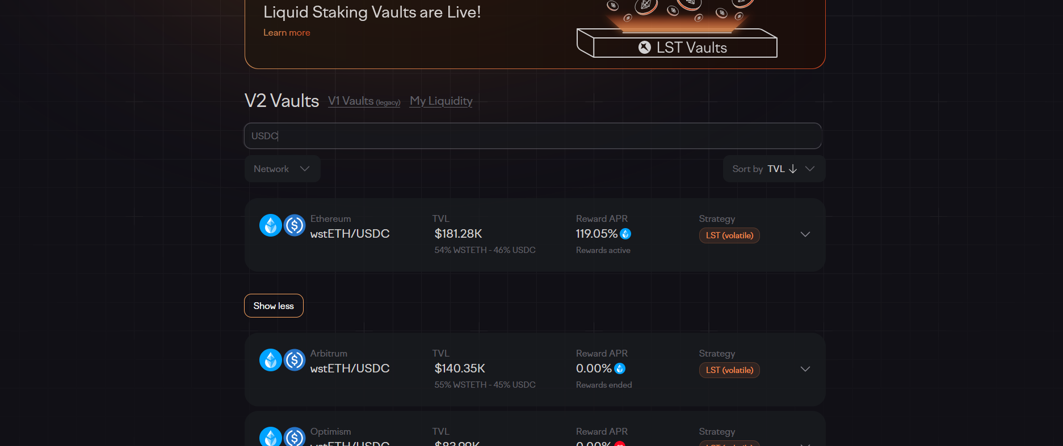
The search results page does not make it clear how many results were retrieved, and if the number of results per page can be configured by the user. The platform also does not effectively rank search results by relevance.

Slide 35
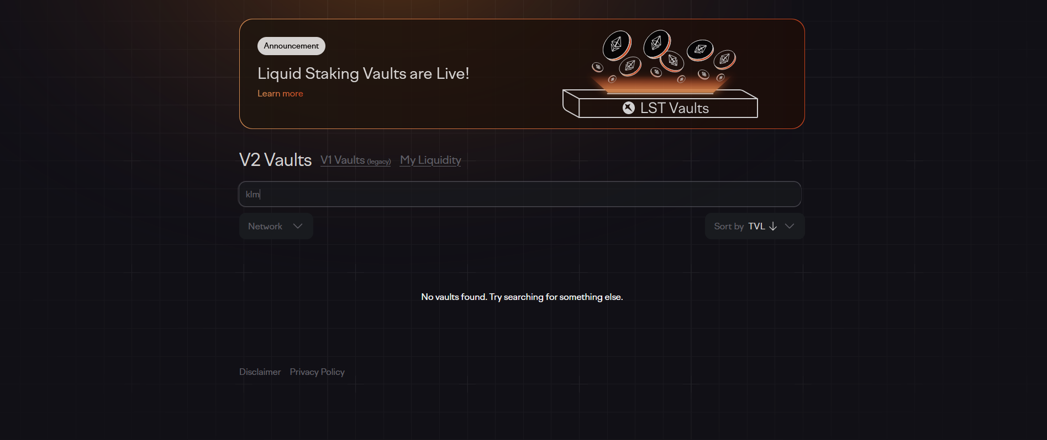
The current platform fails to provide users with helpful suggestions or options when no results are returned from a query.

Slide 36
ARRAKIS FINANCE
UX AUDIT REPORT
HELP, FEEDBACK AND ERROR TOLERANCE
These guidelines help assess if the site helps prevent customers from making errors. A site is error-tolerant if, despite evident errors in input, the intended result may be achieved with either no or minimal corrective action by the customer.

Slide 37
Issue (MEDIUM)
Recommendations
The platform does not provide demonstrations or guided tutorials to showcase how to perform common tasks or utilize key features. Users may face challenges in understanding how to navigate the platform, complete actions, or leverage the available functionalities effectively.
The platform does not prompt users before automatically correcting their erroneous input. Users may not be aware of mistakes in their input, and the platform's failure to provide suggestions or alternatives can result in inaccurate or undesired outcomes
Develop interactive tutorials or guided tours that walk users through common tasks and demonstrate the platform's functionality. These tutorials should provide step-by-step instructions, highlighting key features and interactions, and allowing users to practice and apply their learnings in real-time.
Introduce error correction prompts that appear when the user's input is potentially incorrect or misspelled. These prompts should provide suggestions or alternatives based on common errors or closely related terms, allowing users to review and correct their input if needed.

Slide 38
ARRAKIS FINANCE
UX AUDIT REPORT
TRANSPARENCY OF DATA PROVENANCE
Does the application clearly indicate which data comes from the blockchain and which does not?
Are the addresses of the contracts clearly stated?
Are all blockchain data linked to independent blockchain explorers?
Is it clear which data comes from oracles?

Slide 39
Issue (LOW)
Recommendations
Arrakis does not clearly indicate which data originates from the blockchain and which data does not.
The Platform does not provide clear indications regarding the origin of data from oracles
Improve Data Indication: Clearly differentiate between data originating from the blockchain and data from other sources.
Enhance Oracle Data Transparency: Clearly disclose the sources of data obtained from oracles

Slide 40
ARRAKIS FINANCE
UX AUDIT REPORT
TRANSPARENCY OF TRANSACTIONS
Are irreversible actions clearly indicated?
Are actions involving money or value clearly indicated?
Are actions that could potentially lead to user identification clearly indicated?
Are actions that generate new contracts in the user's name clearly indicated?
Does the application clarify and confirm the new future state in advance?
Is the data being used for a transaction shown in a human-readable format?
Are suggested values for gas price clarified and how to overwrite the transaction?
Is transaction wait time managed effectively

Slide 41
Issue (LOW)
Recommendations
Arrakis fails to clearly indicate actions that could potentially lead to user identification. This lack of clarity raises significant concerns regarding user privacy and data protection.
Unclear Gas Price Suggestions: The platform fails to offer clear and concise explanations or tooltips regarding the suggested gas prices for transactions. Users may struggle to understand the significance of these values, leading to uncertainty in decision-making.
Improve User Identification Disclosure: Clearly indicate any actions or processes that may result in user identification, ensuring users are informed about the potential risks and implications
Clear Gas Price Explanations: Implement concise and user-friendly tooltips or information icons next to suggested gas prices. These should provide users with a brief explanation of the significance of gas prices, helping them make informed decisions based on transaction priorities.
Dynamic Gas Price Recommendations: Implement a dynamic system that updates gas price suggestions in real-time based on current market conditions.

Slide 42
ARRAKIS FINANCE
UX AUDIT REPORT
TRANSPARENCY OF SMART CONTRACT EVENTS
Are all events, even those for developer purposes, clarified and made accessible to the end user?
Are interrupting messages shown only for information relevant to the current user?
Can users subscribe to, unsubscribe from, or temporarily mute certain events?

Slide 43
Issue (LOW)
Recommendations
Obscured Developer Events: The platform does not adequately clarify or make visible events that are primarily designed for developers. This lack of transparency prevents end users from comprehending the full scope of activities occurring within the platform.
Clearly Label Developer Events: Introduce a clear and consistent labeling system to denote events that are primarily geared towards developers. This labeling should be visible in event listings, calendars, and any relevant sections where users explore upcoming activities.

Slide 44
ARRAKIS FINANCE
UX AUDIT REPORT
TRANSPARENCY AND ACCESSIBILITY OF USER’S INTERACTION HISTORY
Does the application provide a history of all transactions from a given address?
Is it clear where the history is stored (local or server)?
Are tools provided to navigate, search, export, and delete the history cache?

Slide 45
Issue (MEDIUM)
Recommendations
Opaque Transaction History: The application does not adequately communicate or provide visibility into the existence of a comprehensive transaction history associated with a specific address. Users are left unaware of the availability and scope of this information.
Unclear Storage Location: It is not evident whether the transaction history is stored locally on the user's device or on the server. Lack of transparency regarding the storage location hampers user understanding and control over their transaction data.
Visible Transaction History Tab: Introduce a dedicated and prominently placed section or tab within the application interface that clearly indicates the presence of a transaction history associated with a given address. This provides users with easy access and awareness of this essential feature.
Storage Location Transparency: Clearly communicate whether the transaction history is stored locally on the user's device or on the server. Provide this information within the application's settings or information panels to enhance user transparency and confidence.

Slide 46
ARRAKIS FINANCE
UX AUDIT REPORT
TRANSPARENCY OF CODE
Is it clear which blockchain is being used?
Are the addresses of the Smart Contracts used in read/write operations clarified?
Is it clear which code is open source and where to find it?
Is it clear where code is being run (local vs remote server)?
Is the web3 provider / Blockchain node clarified?

Slide 47
Issue (LOW)
Recommendations
Ambiguity in Open Source Code: It is unclear which portions of the platform's code are open source, and users are not provided with clear guidance on where to access this open-source code. This lack of transparency hinders users who may seek to review or contribute to the codebase.
Obscured Execution Environment: Users lack information about where the platform's code is being executed—whether locally on their device or on remote servers. This ambiguity raises concerns about the security and privacy implications of code execution.
Clear Source Code Documentation: Introduce clear and concise documentation within the platform that explicitly states which portions of the code are open source. Additionally, provide users with easily accessible links or instructions on where to find and review the open-source code, promoting transparency and community engagement.
Execution Environment Indicators: Clearly indicate the execution environment of the code, distinguishing between local and remote server execution. This information could be displayed in settings or information panels, ensuring users are aware of where their code is running and addressing concerns related to privacy and security.

Slide 48
ARRAKIS FINANCE
UX AUDIT REPORT
HUMAN READABLE HASHES FORMAT
Are compact versions of the hashes shown but always showing the initial and end parts?
Are users allowed to expand the full address/hash?
Can users easily copy it?
Is a custom human readable name or text associated with the addresses and hashes?

Slide 49
Issue (MEDIUM)
Recommendations
Inability to Expand Full Address/Hash: Users are not provided with a mechanism to expand the full details of addresses or hashes, restricting their ability to view the complete information associated with these identifiers.
Challenges in Copying: Users face difficulties in copying addresses or hashes easily. The absence of intuitive copy options may result in a cumbersome process, impacting user efficiency and convenience.
Expandable Address/Hash Details: Implement a user-friendly solution that allows users to expand the full details of addresses or hashes with a single click or tap. This can be achieved through an interactive tooltip, modal, or expandable section, providing users with comprehensive information.
Copy-to-Clipboard Functionality: Introduce an easily accessible "Copy" button or icon adjacent to addresses or hashes, enabling users to copy the information effortlessly. Additionally, consider incorporating a visual indicator or confirmation to assure users that the copy action has been successfully completed.

Slide 50
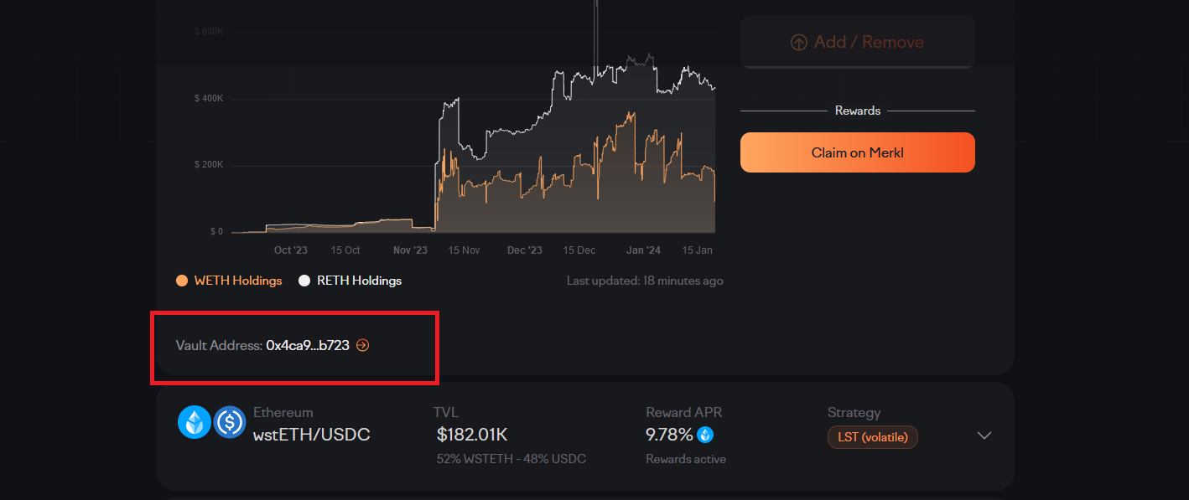
Users are not provided with a mechanism to expand the full details of addresses or hashes nor can they easily copy the address.

Slide 51
ARRAKIS FINANCE
UX AUDIT REPORT
PERMANENT NEWBIE MODE
Is educational information woven into normal interaction?
Are there 2 or more levels of educational content: Blockchain basics and Dapp specific lingo?
Is the amount of new things and concepts that the user needs to learn minimized and increased progressively?

Slide 52
Issue (MEDIUM)
Recommendations
Lack of Educational Tiering: The platform does not offer distinct levels of educational content, making it challenging for users to progress from foundational Blockchain basics to more advanced Dapp-specific lingo. This absence of tiering impedes users' structured learning.
Absence of Progressive Learning: The platform introduces an overwhelming amount of new concepts without a clear and gradual progression. Users may feel inundated with information, leading to cognitive overload and potentially hindering their ability to absorb and retain knowledge effectively.
Two-Tiered Educational Structure: Implement a clear and structured educational pathway with two distinct levels – one focused on Blockchain basics and another on Dapp-specific lingo. Create separate sections or modules that users can navigate through based on their current knowledge level and learning objectives.
Progressive Learning Modules: Develop a curriculum that follows a progressive learning model, introducing concepts in a logical sequence. Start with foundational Blockchain basics, gradually incorporating Dapp-specific lingo, and allowing users to build on their understanding incrementally.

Slide 53
ARRAKIS FINANCE
UX AUDIT REPORT
GAS PRICE AND TRANSACTION REVERSAL
Is what Gas and Gas price clarified?
Are gas prices ranges suggested and time approximations for the upper and lower bounds clarified?
Are transaction reversals allowed?

Slide 54
Issue (SERIOUS)
Recommendations
Gas Price Ranges and Time Approximations: The platform does not suggest gas price ranges or provide time approximations for the upper and lower bounds. This absence of information makes it challenging for users to estimate transaction costs and plan their interactions accordingly. Clear suggestions and time approximations would help users make informed decisions based on factors like network congestion and gas fees.
Transaction Reversals: The platform does not allow for transaction reversals. This limitation can be problematic if users make unintended or erroneous transactions.
Gas Price Ranges and Time Estimates: Suggest gas price ranges and provide time approximations for the upper and lower bounds. This information will assist users in estimating transaction costs and better planning their interactions based on network conditions and gas fees.
Transaction Reversal Mechanism: Introduce a mechanism for transaction reversals, allowing users to undo unintended or erroneous transactions. This feature will enhance user control, reduce anxiety, and provide a safety net for potential mistakes.

Slide 55
ARRAKIS FINANCE
UX AUDIT REPORT
USABILITY SCORE

Slide 56
154/197
GOOD
Users should be able to use this site or system with relative ease and should be able to complete the vast majority of important tasks.
USABILITY SCORE
Ultimately, the usability score is a quantitative or qualitative representation of how usable and effective a product is in meeting user needs and goals. It helps evaluate the success of UX design and identify areas for improvement to enhance the overall user experience.

Slide 57
ARRAKIS FINANCE
UX AUDIT REPORT
NEXT STEPS

Slide 58
NEXT STEPS
Suggestions to improve the Arrakis Finance experience
#1
Implement Findings -
Follow up the Implementation of the Research Findings on live platform.

Slide 59
ARRAKIS FINANCE
UX AUDIT REPORT
RESOURCES

Slide 60
SOURCES
Explore attached Unabridged UX audit detailed findings on Arrakis Finance
Expert Review Based On web Usability Guidelines Spreadsheet report
Expert review based on Web3 UX Principles by Beltran Spreadsheet report
Expert review collation and usability score report on Airtable spreadsheet Report

Slide 61



www.generalmagic.io

